Slide 1
Mapping Designs to Code
Larman, Chapter 20

Slide 2
Mapping Designs to Code
Write source code for:
  Class and interface definitions
  Method definitions
Work from OOA/D artifacts
  Create class definitions for Domain Class Diagrams (DCDs)
  Create methods from Interaction diagrams

Slide 3
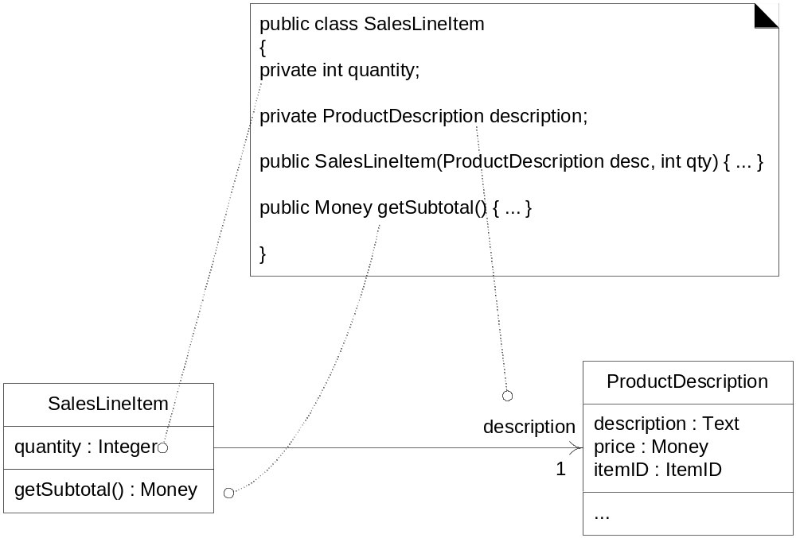
From DCD to Java class
Fig. 20.1

Slide 4
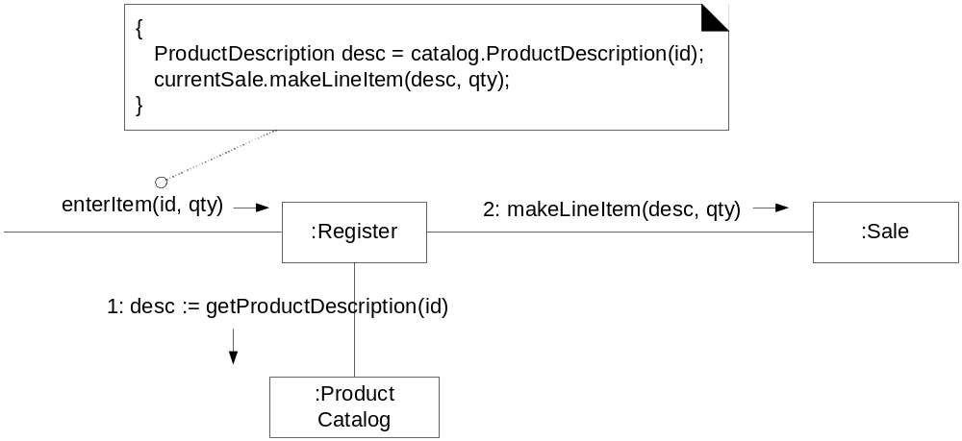
From Interaction diagram to method
Fig. 20.4

Slide 5
Register.enterItem method
Public class Register
{
private ProductCatalogue catalog;
private Sale currentSale;
public Register(ProductCatalog pc)
{….}
Public void endSale()
{….}
Public void enterItem(ItemID id,int qty){…}
Public void makaNewSale(){…}
Public void makePayment(Money cashTendered){..}

Slide 6
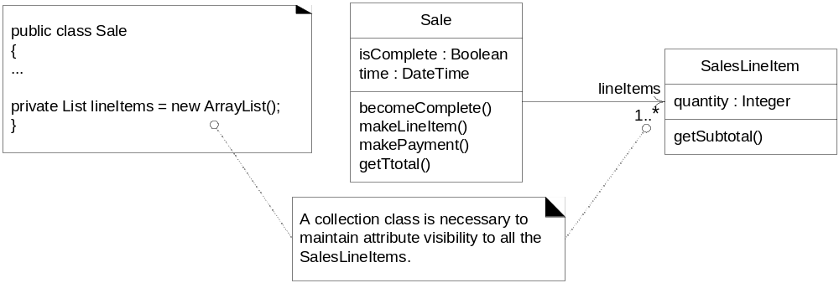
Collection classes
What collection class has been added to the design and why?
Fig. 20.5

Slide 7
Exception handling
Why is it wise to consider large-scale exception handling strategies during design modeling?
In UML, exceptions can be inserted as property strings of messages

Slide 8
Sale.makeLineItem Method
enterItem(id,qty) 2: makeLineItem(desc,qty)
{
lineItems.add(new SalesLineItem(desc,qty)
}
Register
Sale
2.2:add(s)
2.1:create(desc,qty)
lineItems:List<SalesLineItem>
Sl:SalesLineItem

Slide 9
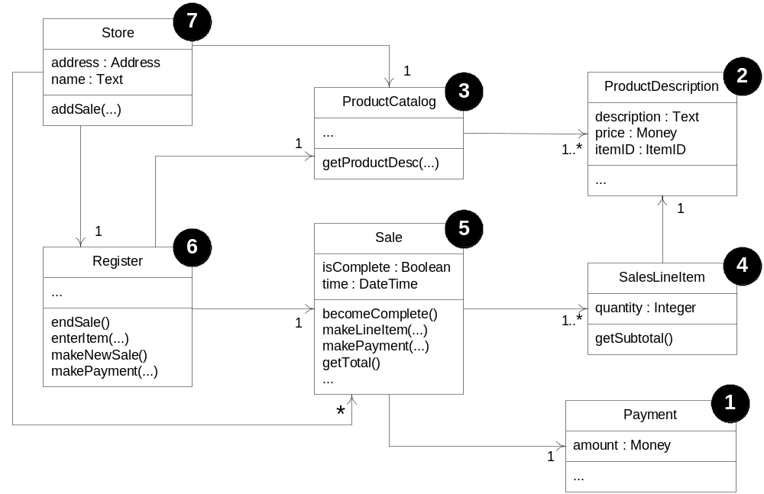
Why implement from least-coupled to most-coupled?
Fig. 20.7

